Slide 1
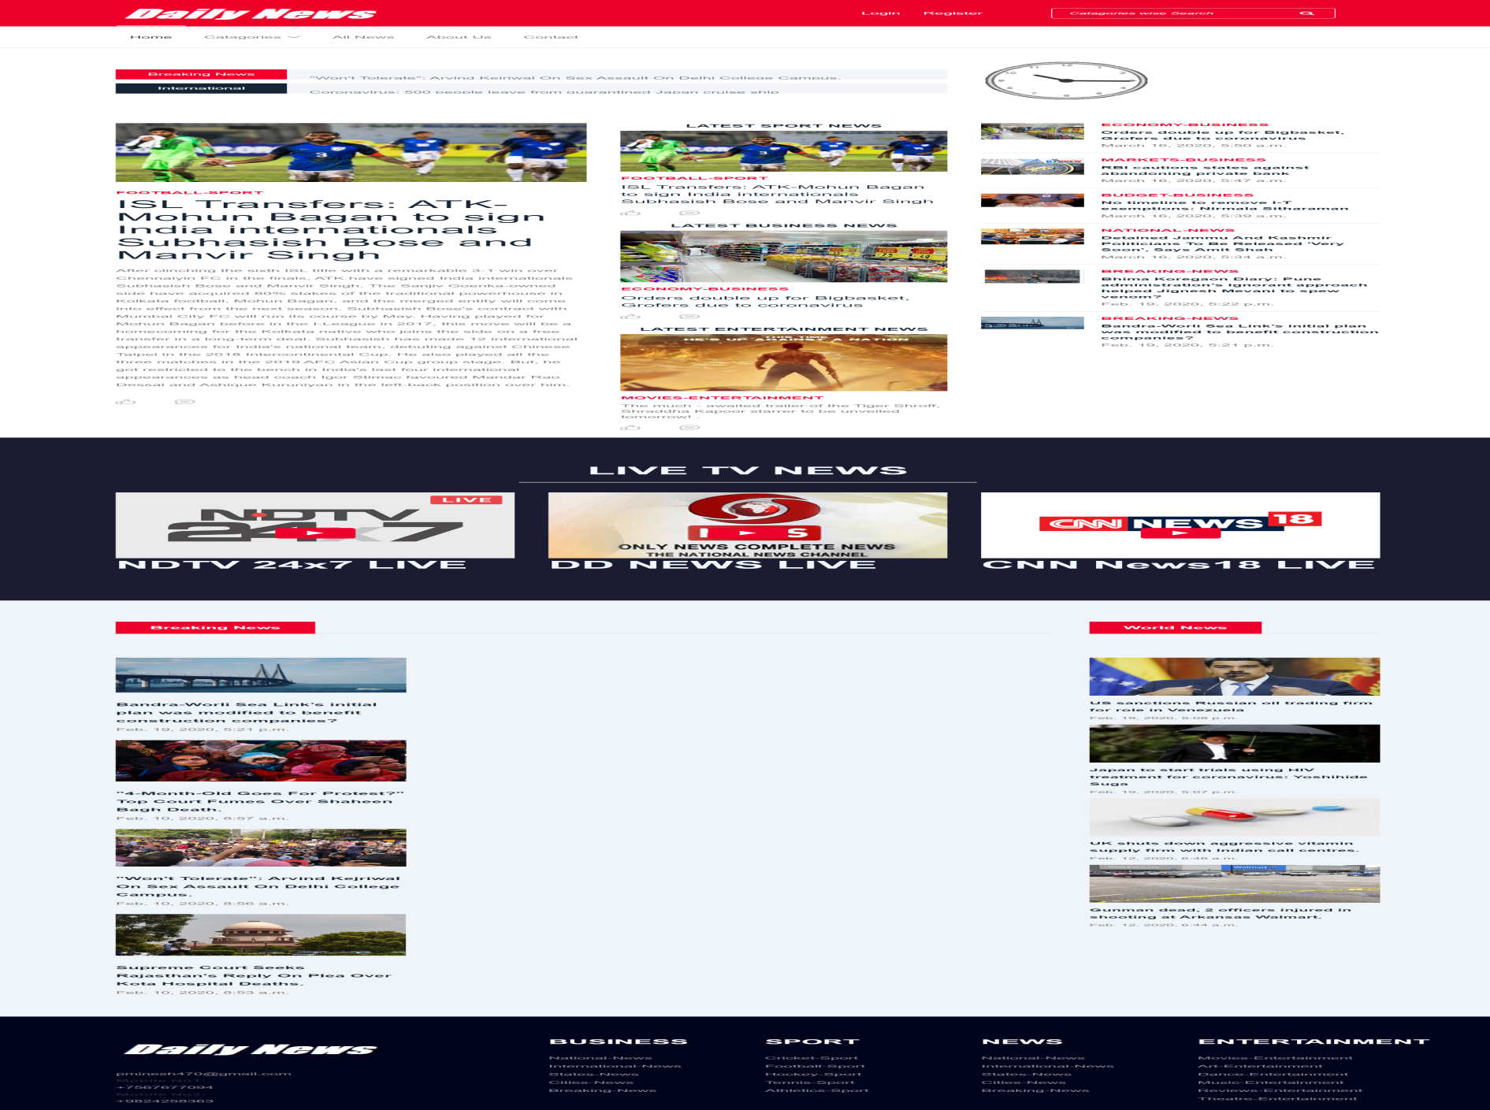
4.5 Input Design(USER)
1.Index Page

Slide 2
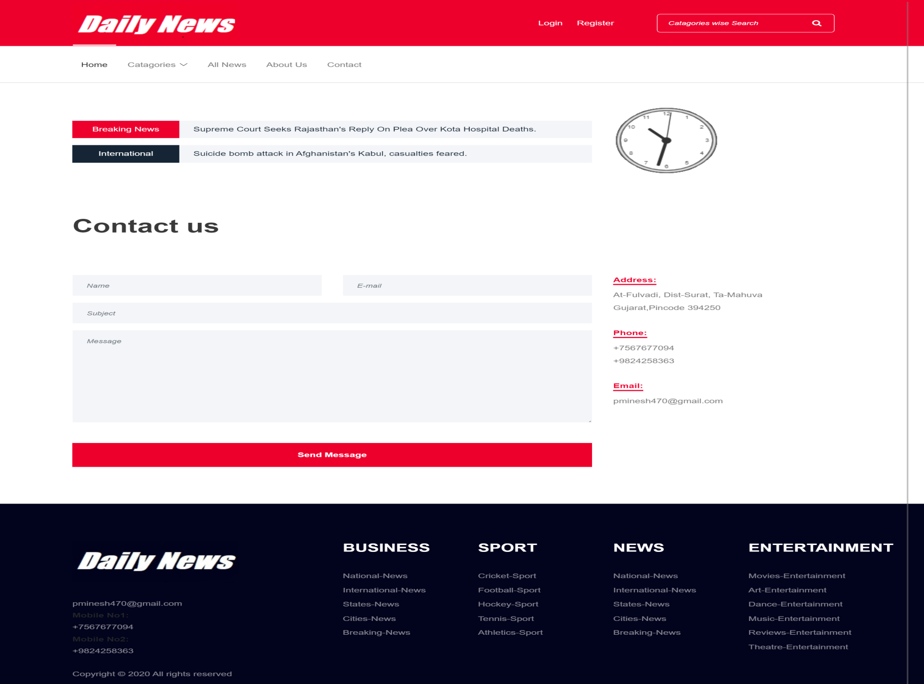
2. Contact Us Page

Slide 3
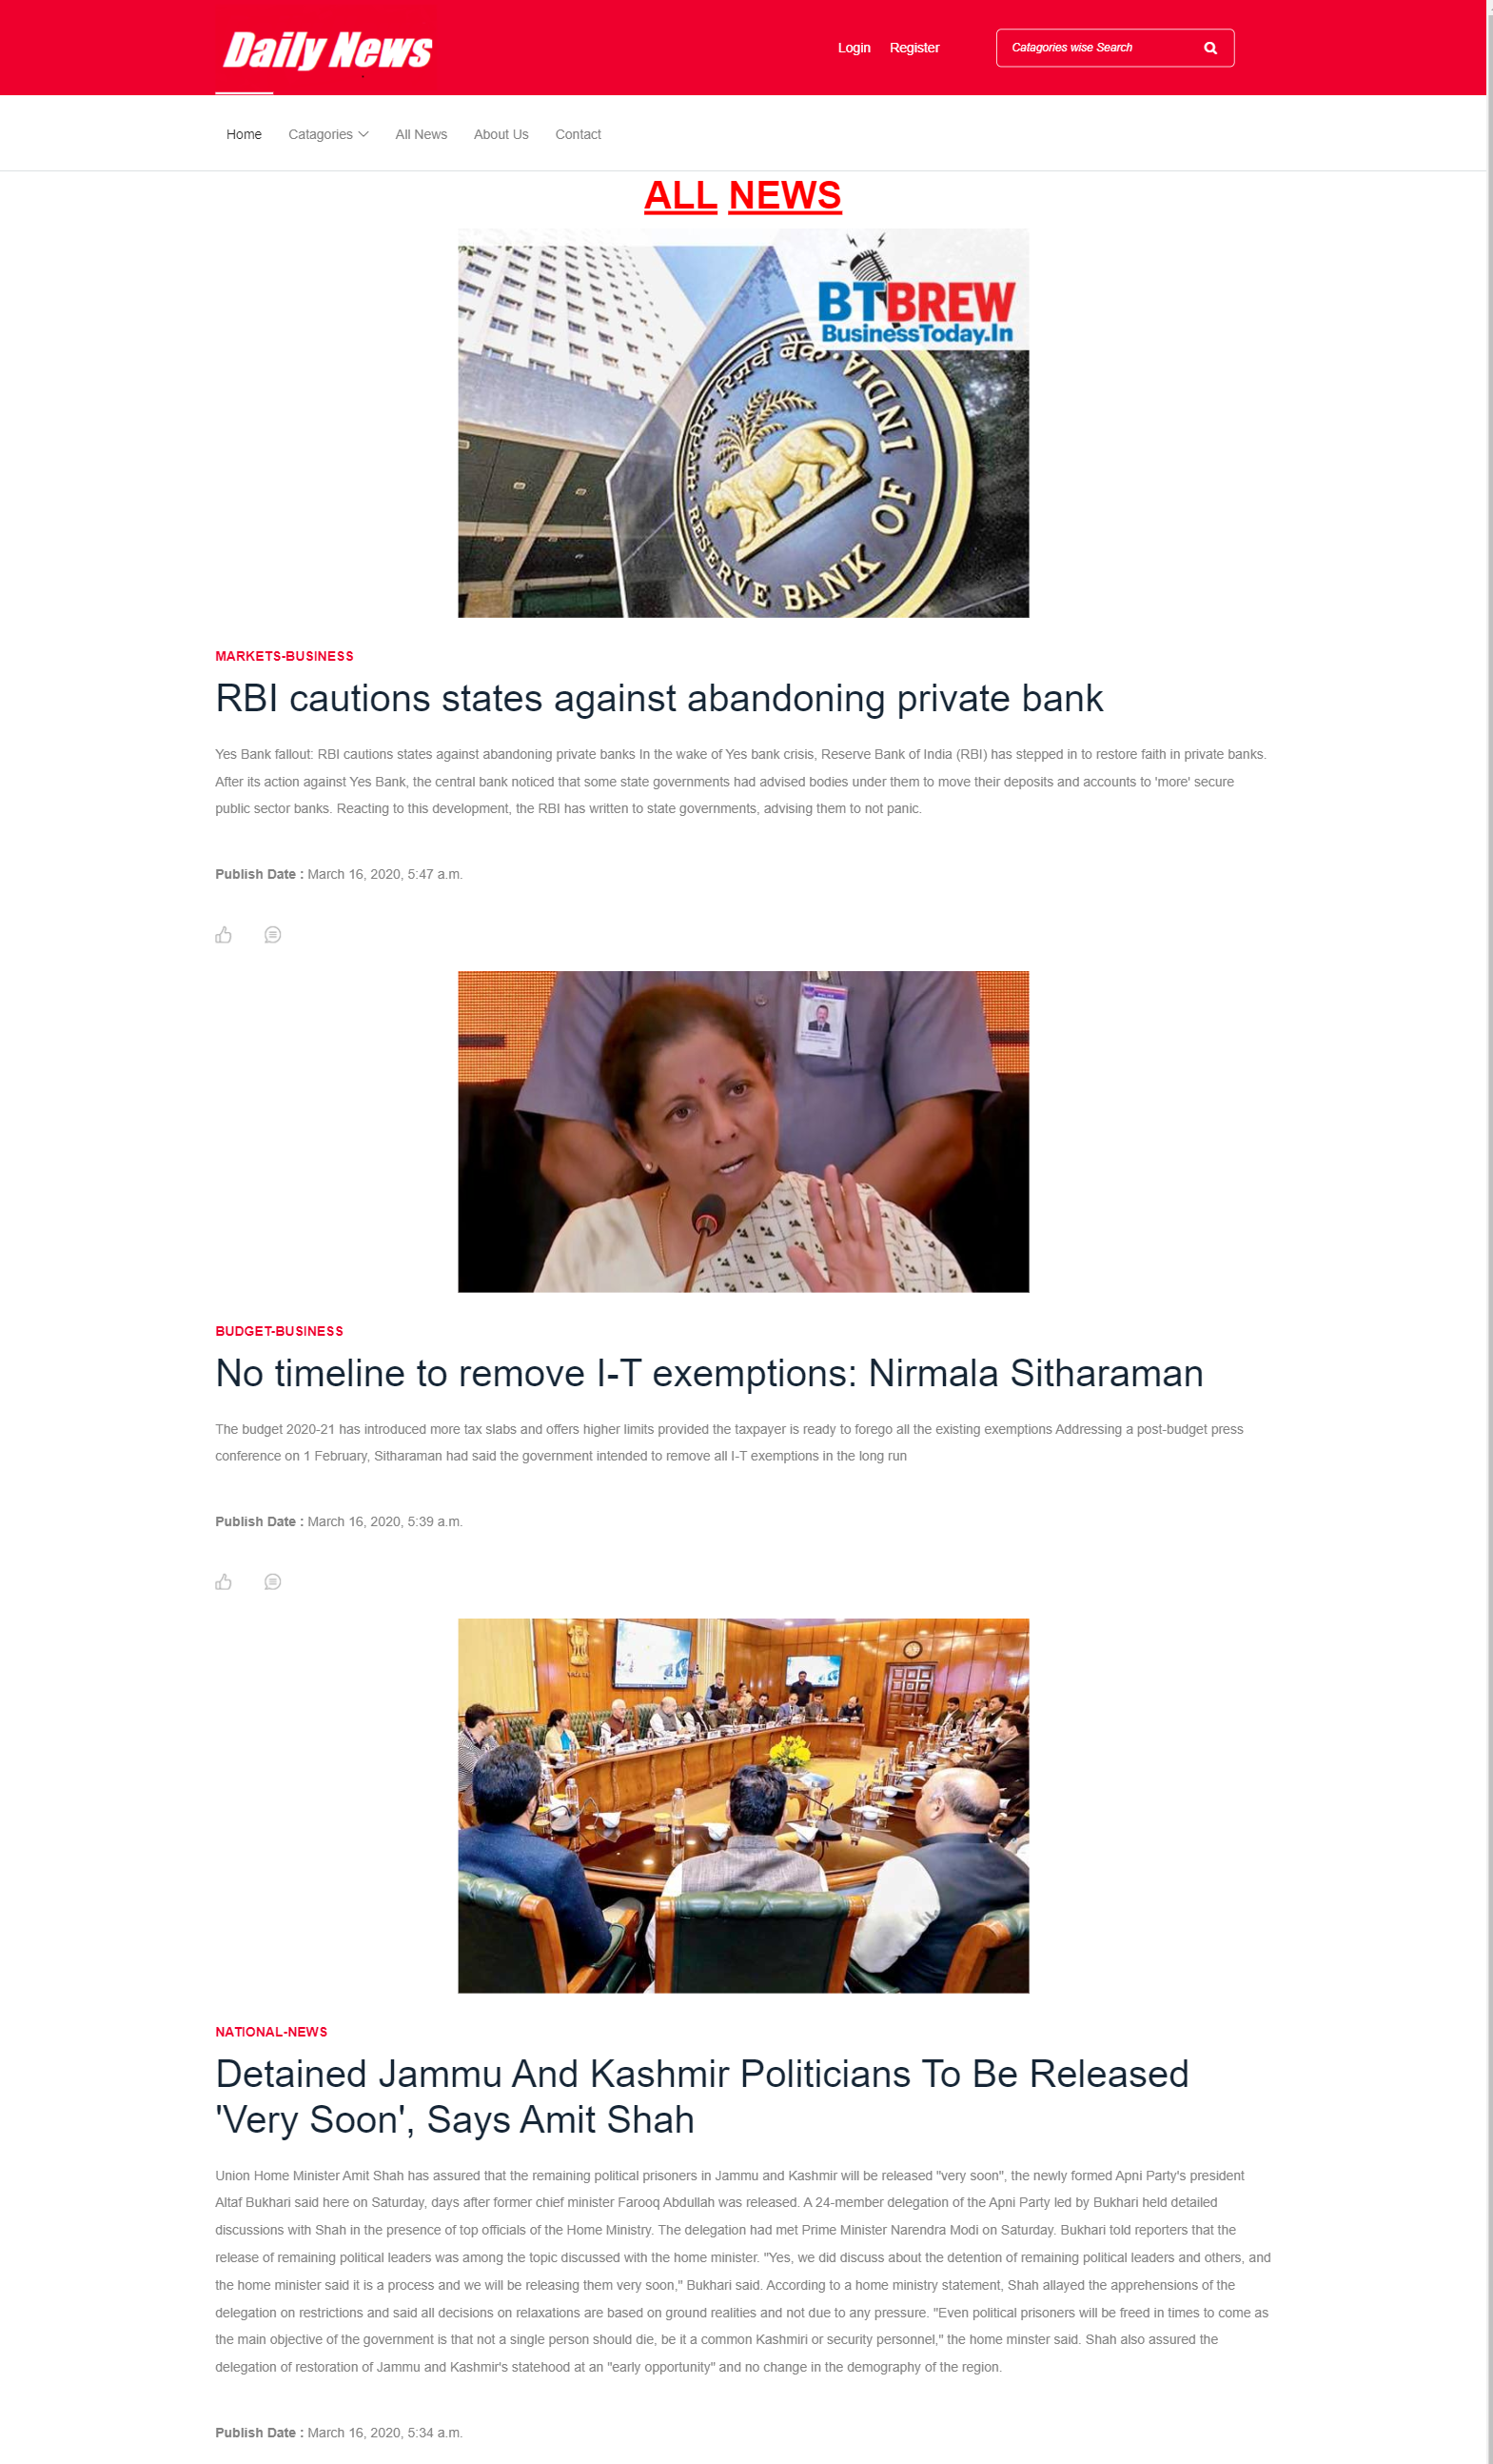
3. All News Page

Slide 4
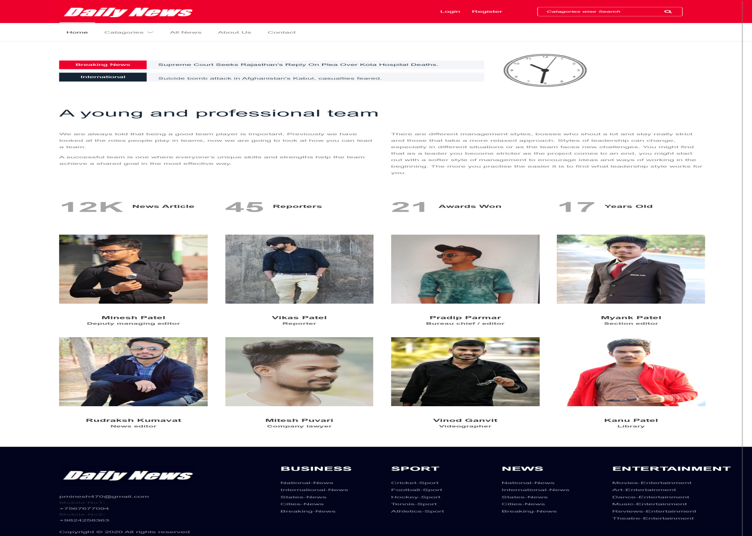
4. About Us Page

Slide 5
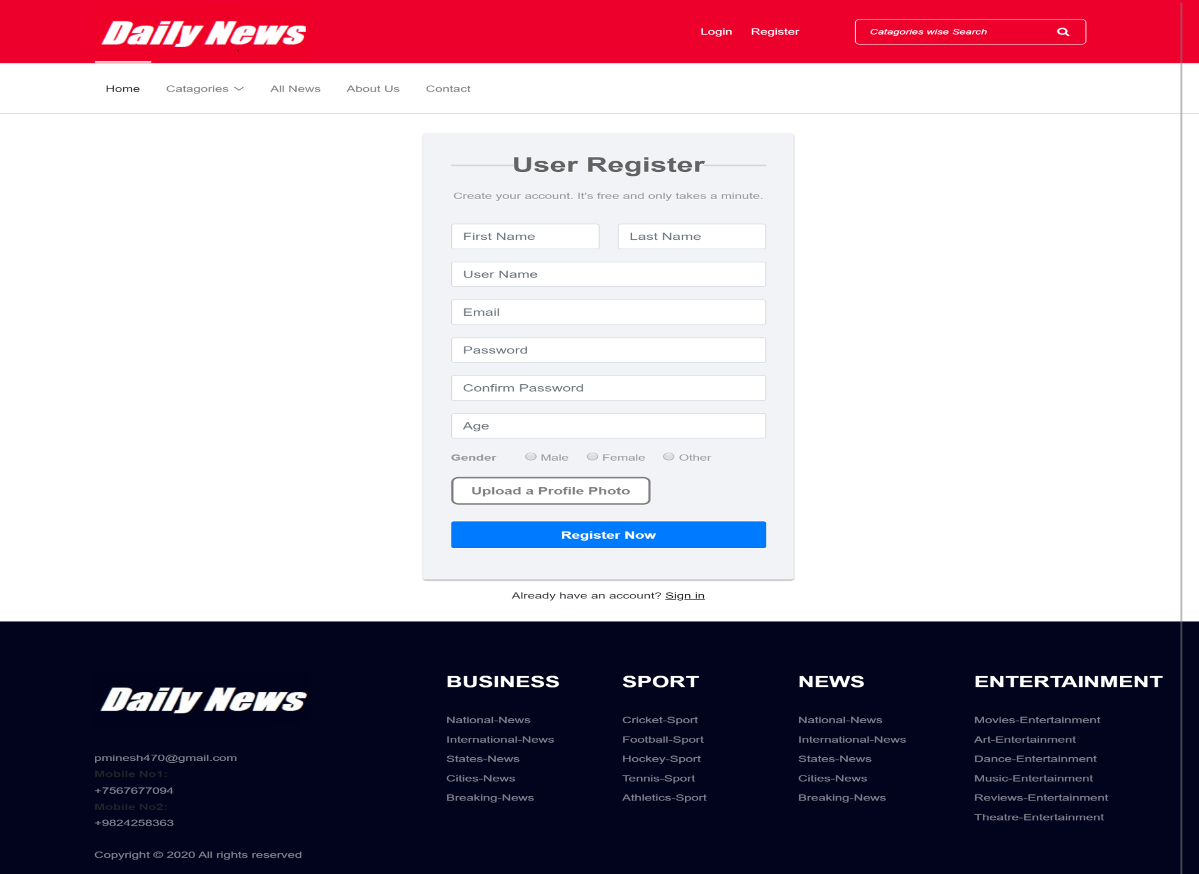
5. Registration Page

Slide 6
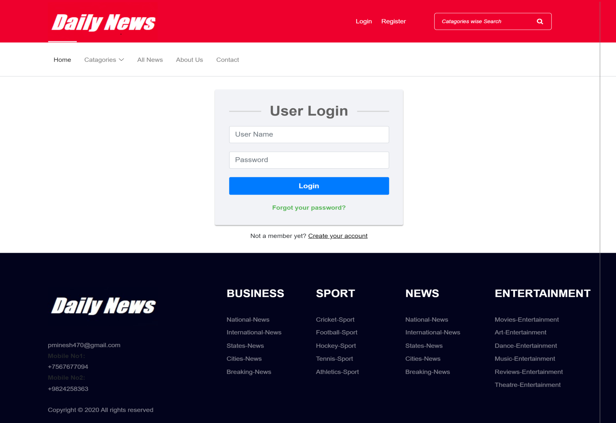
6. Login Page

Slide 7
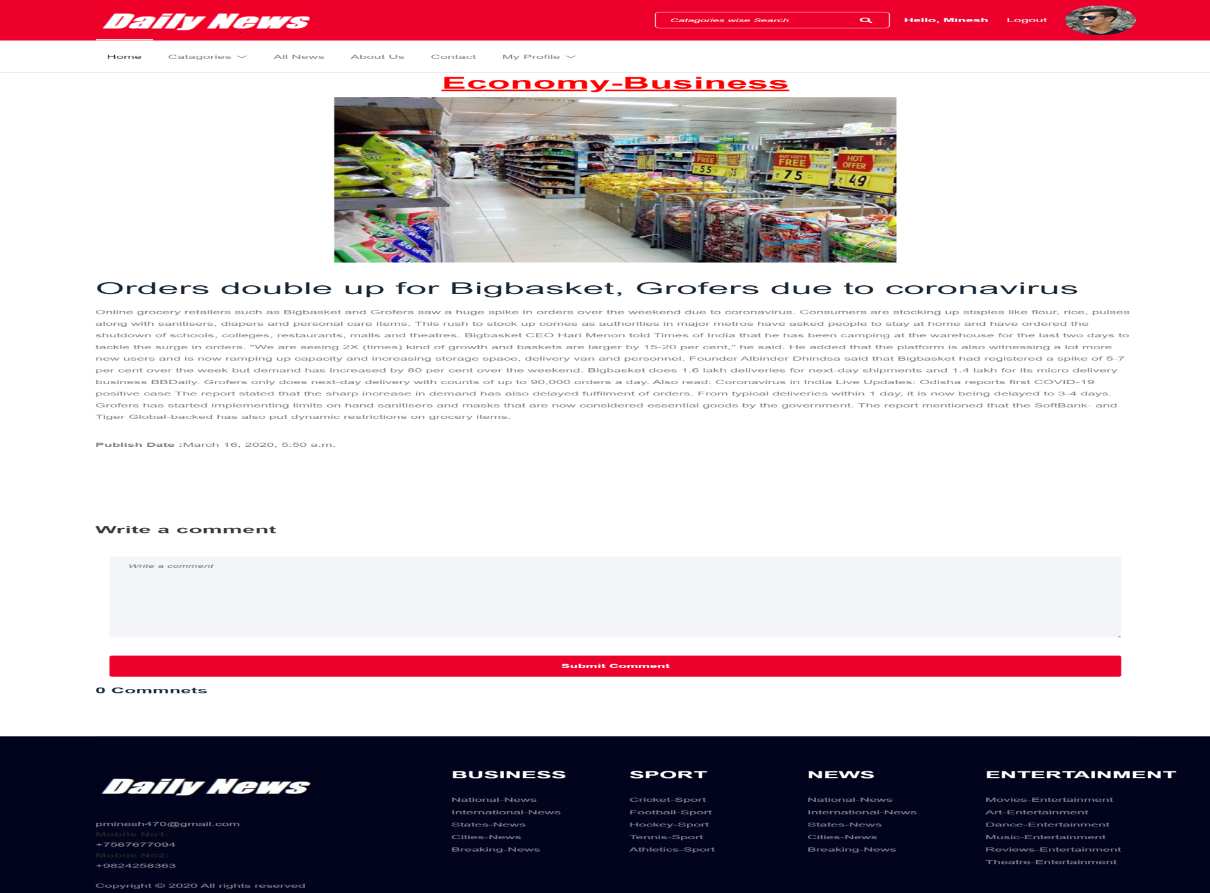
7. Comment Page

Slide 8
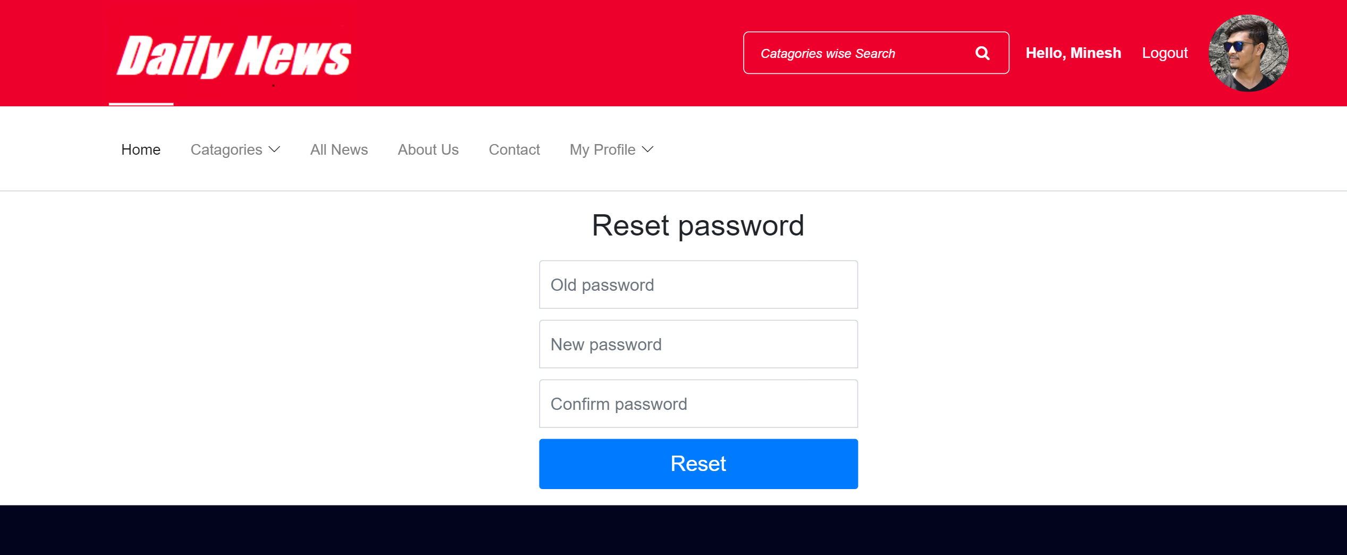
8. Change password Page

Slide 9
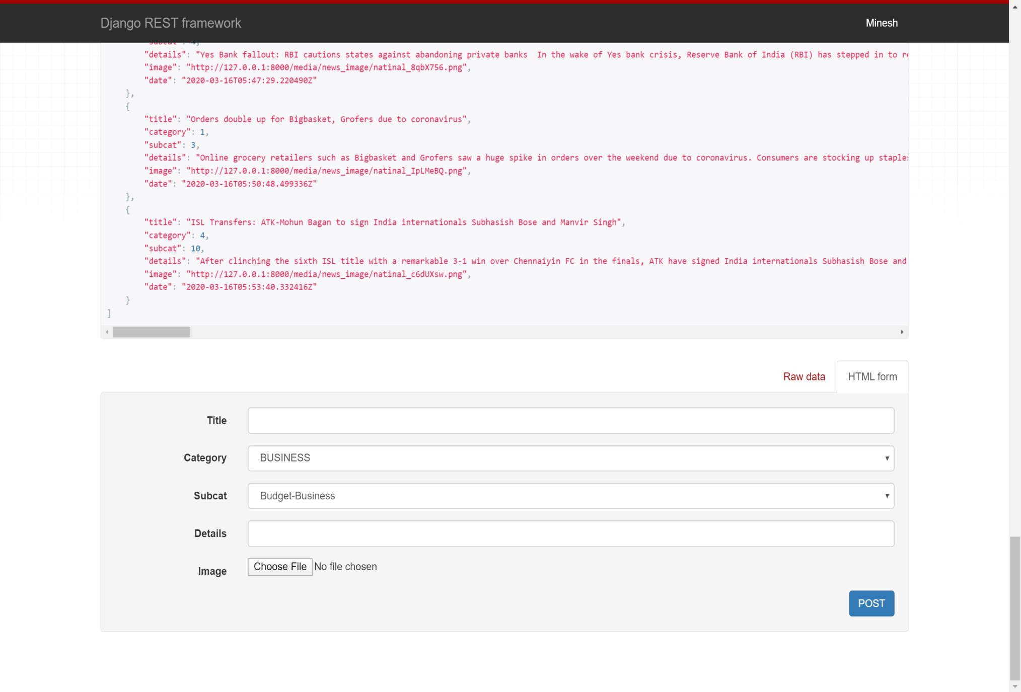
9. Insert News Page

Slide 10
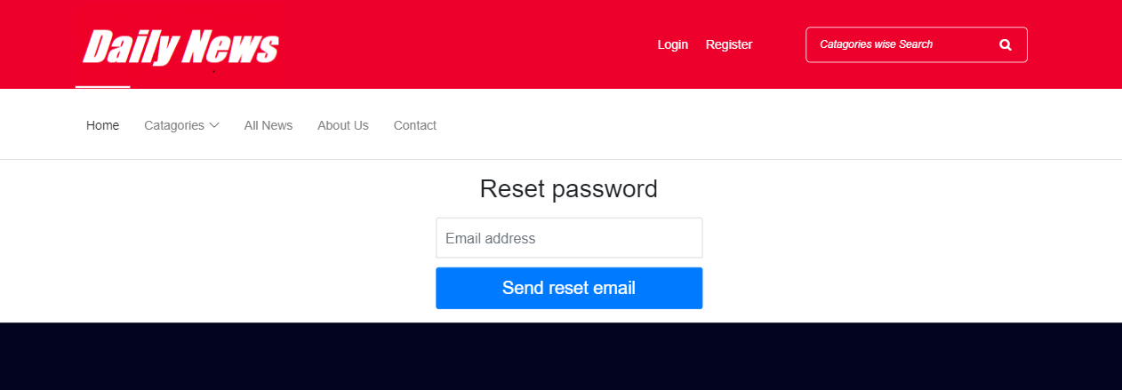
10. Reset password Page

Slide 11

4.5 Input Design(ADMIN)
11. Admin Login Page

Slide 12
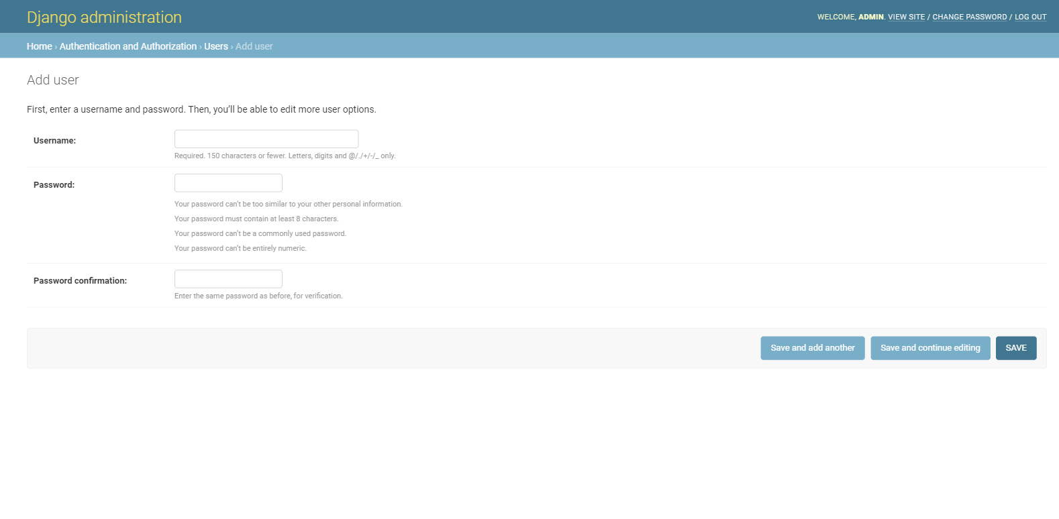
12. Admin Registration Page

Slide 13
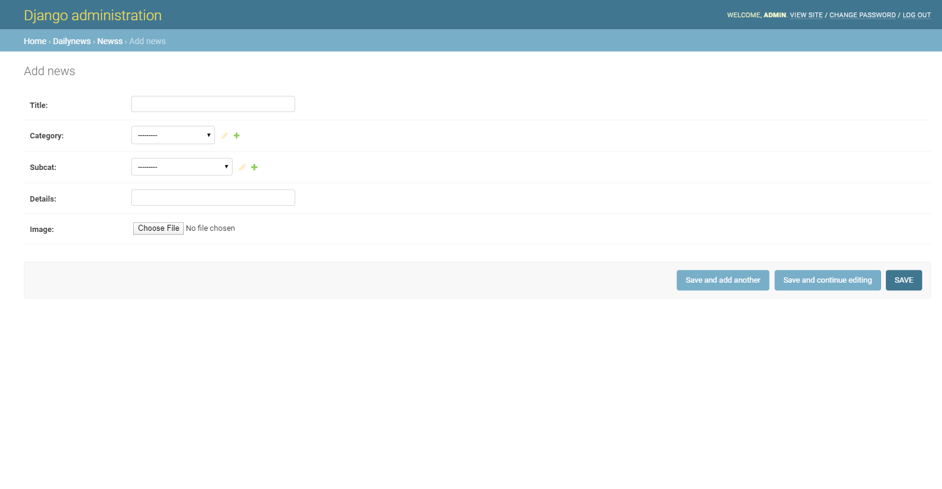
13. Add News Page

Slide 14
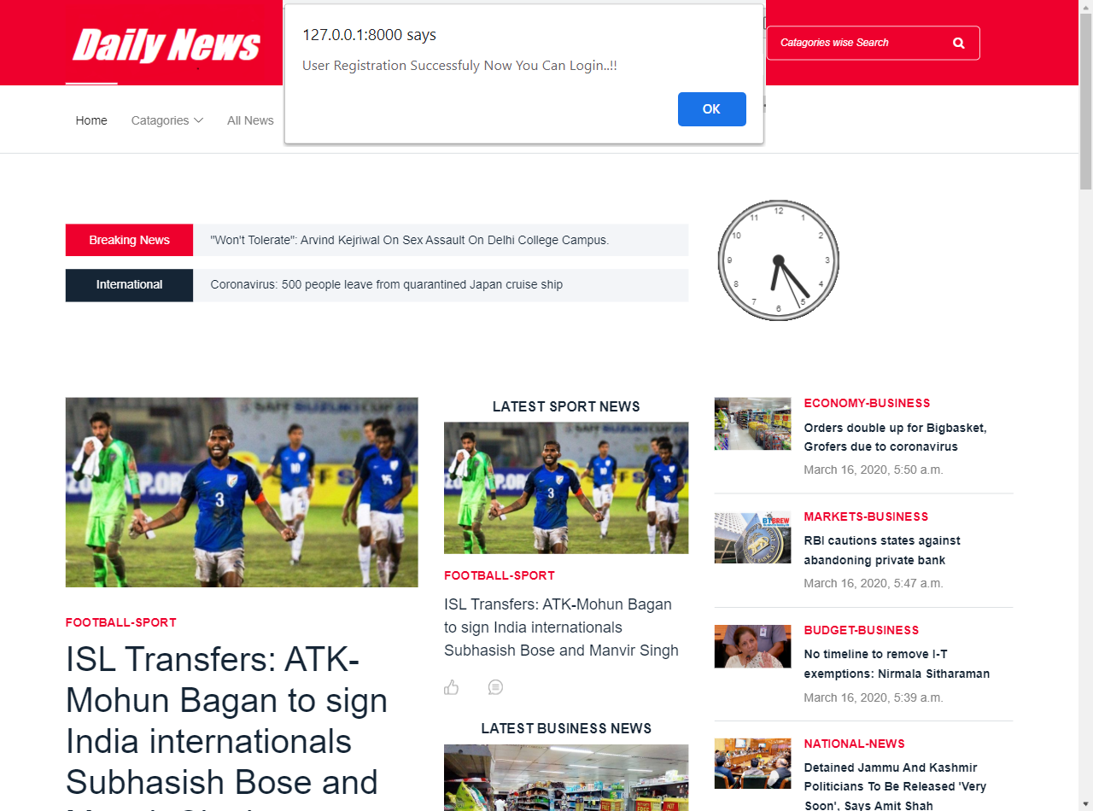
Output Design (USER)
14. User Registration successfully Page

Slide 15
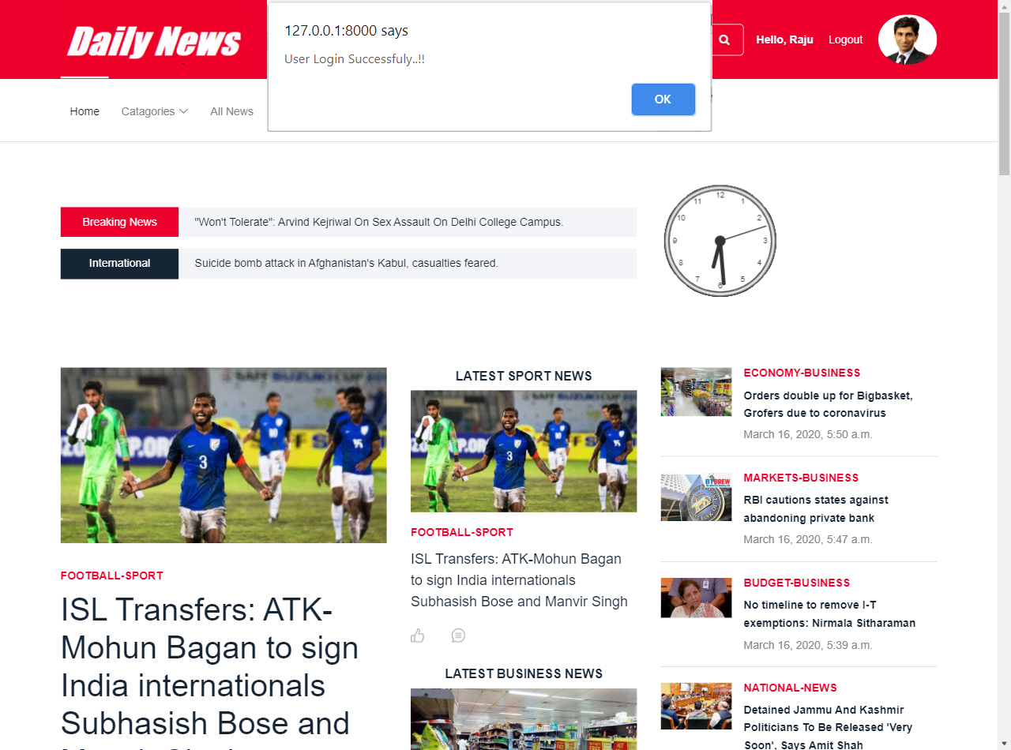
15. User Login successfully Page

Slide 16
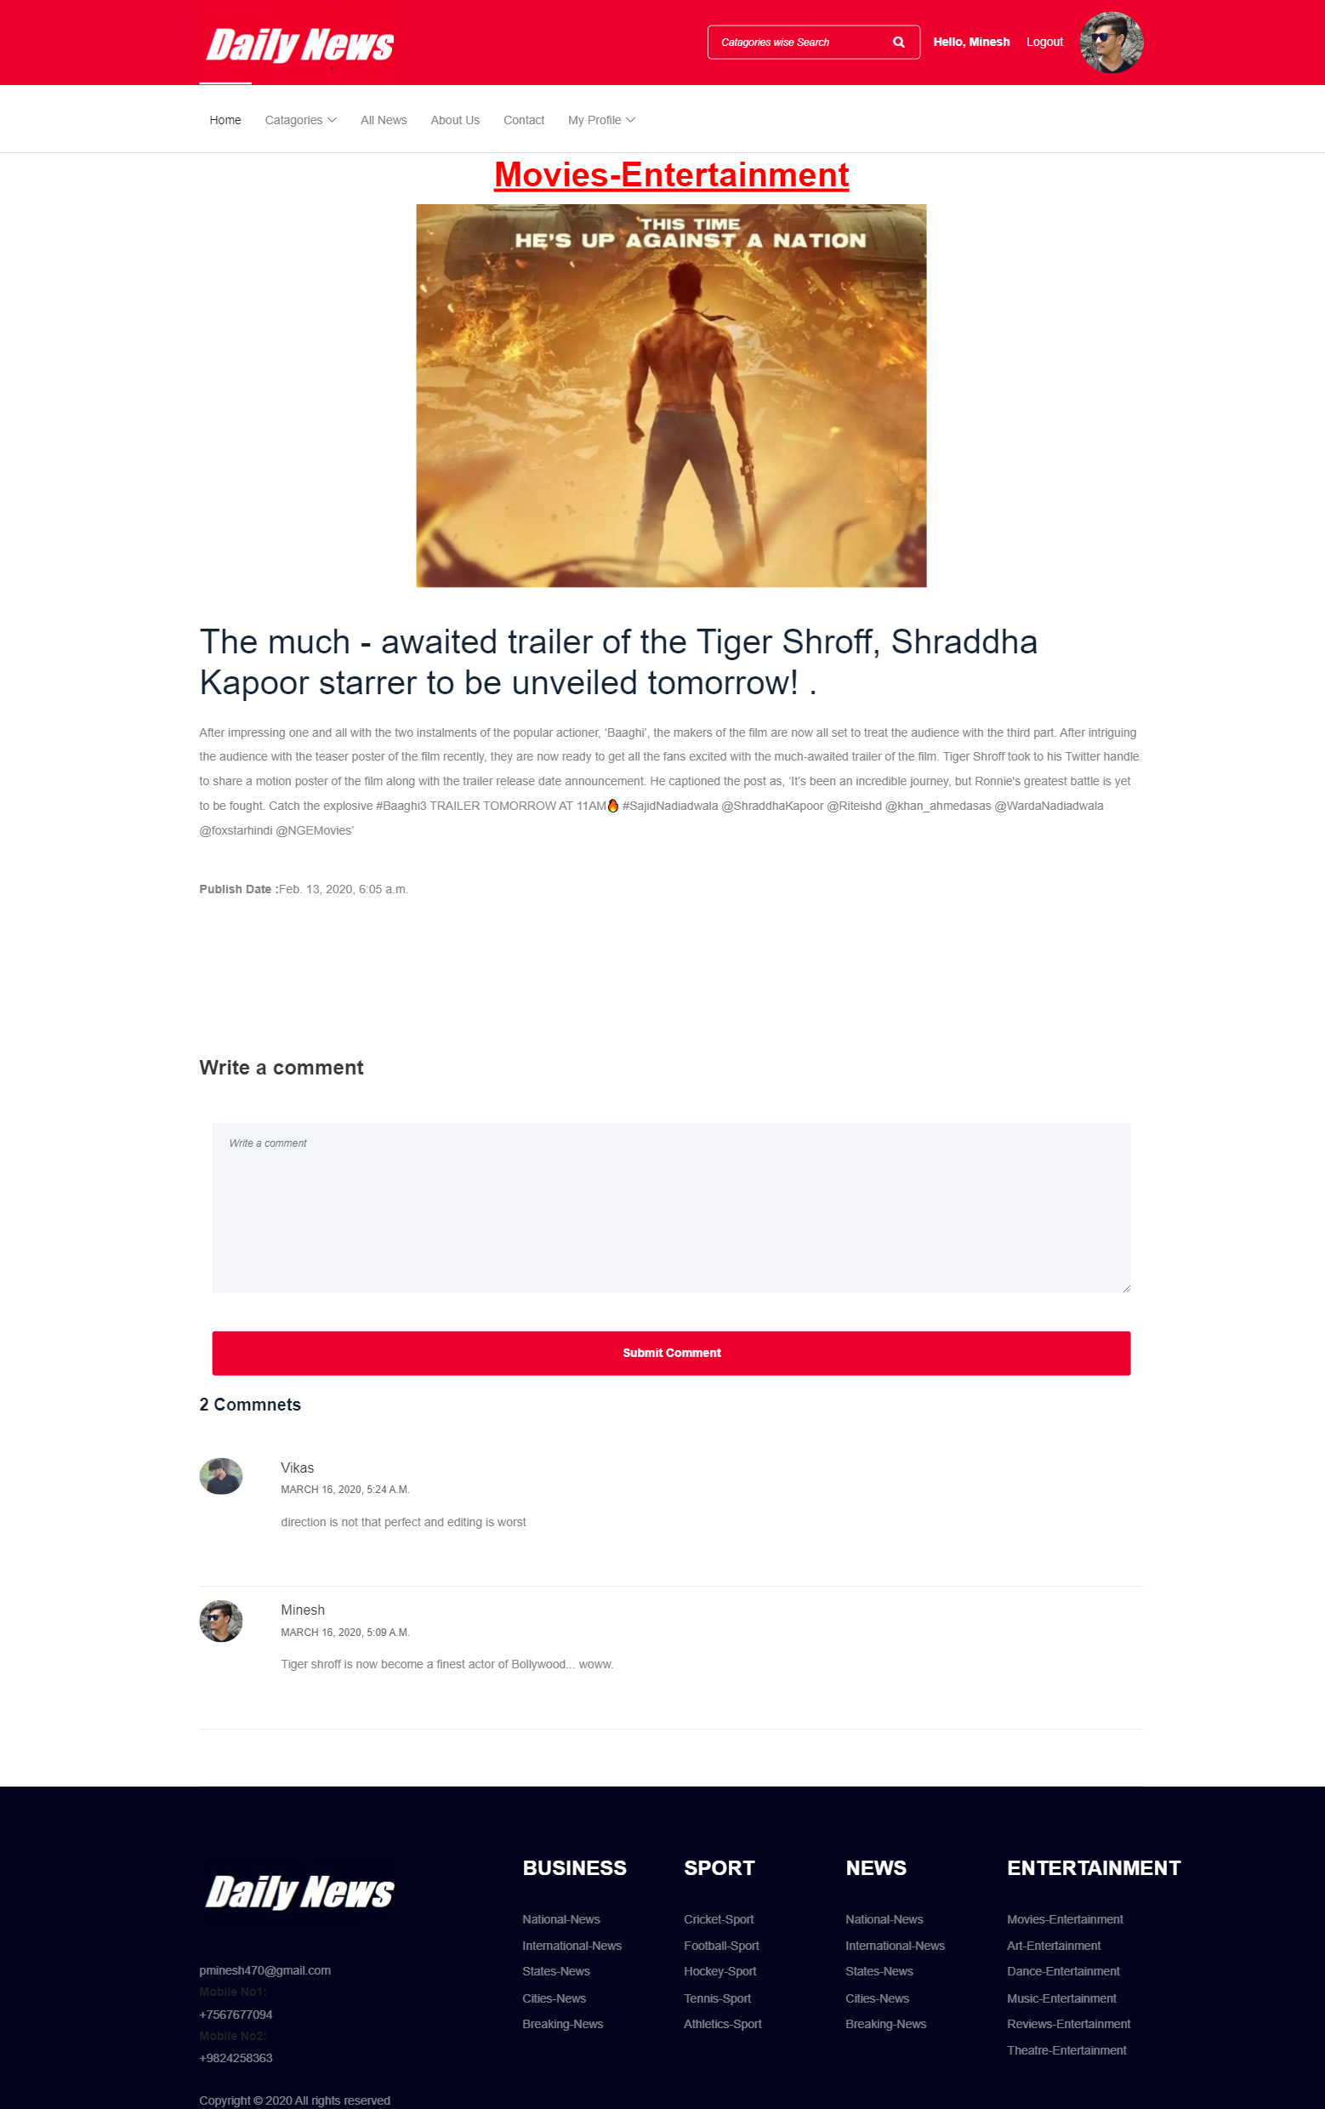
16. User give comments successfully Page

Slide 17
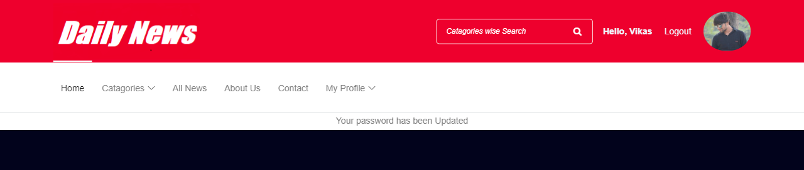
17. User update password successfully Page

